Slide 1

Chapter 4
COGNITIVE ASPECTS

Slide 2
Overview
What is cognition?
Why it is important to understand in HCI
Describe how cognition has been applied to interaction design
Explain what are mental models and how to elicit them
Cover relevant theories of cognition
Notes:
2

Slide 3
What is cognition?
Thinking, remembering, learning, daydreaming, decision-making, seeing, reading, talking, writing…
Ways of classifying cognition at a higher level:
Experiential vs. reflective cognition (Norman, 1993)
Fast vs slow thinking (Kahneman, 2011)

Slide 4
Which involves fast vs slow thinking?
2 + 2 =
21 × 29 =
What color eyes do you have?
How many colors are there in the rainbow?
How many months in the year have 31 days?
What is the name of the first school you attended?

Slide 5
How can understanding cognition help?
Provides knowledge about what users can and cannot be expected to do
Identifies and explains the nature and causes of problems that users encounter
Provides theories, modeling tools, guidance, and methods that can lead to the design of better interactive products
Notes:
5

Slide 6
Cognitive processes
Attention
Perception
Memory
Learning
Reading, speaking and listening
Problem-solving, planning, reasoning and decision-making
Notes:
6
It is important to note that many of these cognitive processes are interdependent: several may be involved for a given activity. It is rare for one to occur in isolation. For example, when you try to learn material for an exam, you need to attend to the material, perceive and recognize it, read it, think about it, and try to remember it. Below we describe the various kinds in more detail, followed by a summary box highlighting core design implications for each. Most relevant for interaction design are attention and memory which we describe in greatest detail.

Slide 7
Attention
Selecting things on which to concentrate at a point in time from the mass of stimuli around us
Allows us to focus on information that is relevant to what we are doing
Involves audio and/or visual senses
Focused and divided attention
Enables us to be selective in terms of the mass of competing stimuli, but limits our ability to keep track of all events
Design recommendation
Information at the interface should be structured to capture users’ attention, for example, use perceptual boundaries (windows), color, reverse video, sound, and flashing lights
Notes:
7

Slide 8

Activity: Find the price for a double room at the Quality Inn in Pennsylvania
Notes:
8

Slide 9
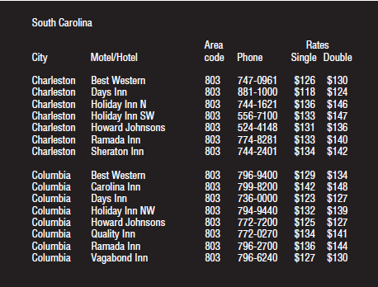
Activity: Find the price of a double room at the Holiday Inn in Columbia
Notes:
9

Slide 10
Activity
Tullis (1987) found that the two screens produced quite different results
1st screen: Took an average of 5.5 seconds to search
2nd screen: Took 3.2 seconds to search
Why, since both displays have the same density of information (31percent)?
Spacing
In the 1st screen, the information is bunched up together, making it hard to search
In the 2nd screen, the characters are grouped into vertical categories of information making it easier
Notes:
10

Slide 11
Multitasking and attention
Is it possible to perform multiple tasks without one or more of them being detrimentally affected?
Multitasking can cause people to lose their train of thought, make errors, and need to start over
Ophir et al. (2009) compared heavy vs light multitaskers
Heavy multitaskers were more prone to being distracted than those who infrequently multitask
Heavy multitaskers are easily distracted and find it difficult to filter irrelevant information

Slide 12
Multitasking experiment
Lotteridge et al. (2015) conducted another study involving writing an essay under two conditions: relevant or irrelevant information
Heavy multitaskers were easily distracted but able to put this to good use if the distracting sources were relevant to the task in hand
Irrelevant information was found to impact task performance negatively

Slide 13
Multitasking at work
It is increasingly common for workers to multitask
For example, hospital workers have to attend to multiple screens in an operating room that provide new kinds of real-time information
This requires clinician’s constant attention to check if any data is unusual or anomalous
Need to develop new attention and scanning strategies

Slide 14
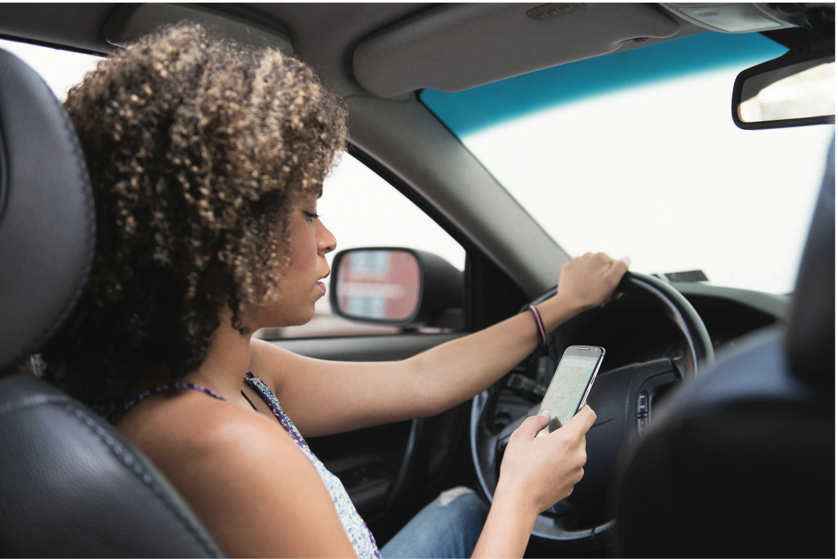
Is it OK to use a phone when driving?

Slide 15
No!
Driving is very demanding
Drivers are prone to being distracted
There is a significant chance of causing accidents
Drivers’ reaction times are longer to external events when talking on the phone in a car (Caird et al., 2018)
Drivers using their phones rely more on their expectations about what is likely to happen next as conducting a conversation takes up their attention
Response time is slower to unexpected events (Briggs et al., 2018)
Drivers often try to imagine what the other person’s face is like− the person to whom they are speaking
Doing so competes with the processing resources needed to enable them to notice and react to what is in front of them

Slide 16
Are hands-free phones safer to use when driving?
No, as same type of cognitive processing is happening when talking
The same thing happens when talking with front seat passenger
But both can stop in mid-sentence if a hazard is spotted allowing the driver to switch immediately to the road
So, it’s less dangerous talking to a front seat passenger than a remote person
A remote person on the end of a phone is not privy to what the driver is seeing and will carry on the conversation when there is a hazard
This makes it difficult for the driver to switch all their attention to the road

Slide 17
Design implications for attention
Context: Make information salient when it needs to be attended to at a given stage of a task
Use techniques to achieve this:
For example, color, ordering, spacing, underlining, sequencing, and animation
Avoid cluttering visual interfaces with too much information
Consider designing different ways to support effective switching and returning to an interface
Notes:
17

Slide 18
Perception
How information is acquired from the world and transformed into experiences
Obvious implication is to design representations that are readily perceivable, for instance:
Text should be legible
Icons should be easy to distinguish and read
Notes:
18

Slide 19
Is color contrast good? Find Italian
Notes:
19

Slide 20
Are borders and white space better? Find French
Notes:
20

Slide 21
Activity
Weller (2004) found people took less time to locate items for information that was grouped
Using a border (2nd screen) compared with using color contrast (1st screen)
Some argue that too much white space on web pages is detrimental to search process
Makes it hard to find information
Do you agree?
Notes:
21

Slide 22

Activity: Which is the easiest to read and why?
What is the time?
What is the time?
What is the time?
What is the time?
What is the time?
Notes:
22

Slide 23
Design implications
Icons should enable users to distinguish their meaning readily
Bordering and spacing are effective visual ways of grouping information
Sounds should be audible and distinguishable
Research proper color contrast techniques when designing an interface:
Yellow on black or blue is fine
Yellow on green or white is a no-no
Haptic feedback should be used judiciously
Notes:
23

Slide 24
Memory
Involves recalling various kinds of knowledge that allow people to act appropriately
For example, recognizing someone’s face or remembering someone’s name
First encode and then retrieve knowledge
We don’t remember everything−it involves filtering and processing what is attended to
Context is important as to how we remember (that is, where, when, how, and so on)
We recognize things much better than being able to recall things
We remember less about objects that we have photographed than when we observe them with the naked eye (Henkel, 2014)
Notes:
24

Slide 25
Processing in memory
Encoding is first stage of memory
Determines which information is attended to in the environment and how it is interpreted
The more attention paid to something…
The more it is processed in terms of thinking about it and comparing it with other knowledge…
The more likely it is to be remembered
For example, when learning about HCI, it is much better to reflect upon it, carry out exercises, have discussions with others about it, and write notes than just passively read a book, listen to a lecture or watch a video about it
Notes:
25

Slide 26
Context is important
Context affects the extent to which information can be subsequently retrieved
Sometimes it can be difficult for people to recall information that was encoded in a different context:
“You are on a train and someone comes up to you and says hello. You don’t recognize him for a few moments, but then realize it is one of your neighbors. You are only used to seeing your neighbor in the hallway of your apartment building, and seeing him out of context makes him difficult to recognize initially”
Notes:
26

Slide 27
Activity
Try to remember the dates of your grandparents’ birthday
Try to remember the cover of the last two books you read
Which was easiest? Why?
People are very good at remembering visual cues about things
For instance, the color of items, the location of objects and marks on an object
They find it more difficult to learn and remember arbitrary material
For example, birthdays and phone numbers
Notes:
27

Slide 28
Recognition versus recall
Command-based interfaces require users to recall from memory a name from a possible set of 100s of names
Graphical interfaces provide visually-based options (menus, icons) that users need only browse through until they recognize one
Web browsers provide tabs and history lists of visited URLs that support recognition memory
Notes:
28

Slide 29
The problem with the classic ‘7,+ or − 2’
George Miller’s (1956) theory of how much information people can remember
People’s immediate memory capacity is very limited to 7, + or − 2
Has been applied in interaction design when considering how many options to display
But is it a good use of a theory in HCI?
Is it helpful?
Notes:
29

Slide 30
When creating an interface, should the designer…
Present only 7 options on a menu
Display only 7 icons on a tool bar
Have no more than 7 bullets in a list
Place only 7 items on a pull down menu
Place only 7 tabs on the top of a website page?
Not necessarily…
Notes:
30

Slide 31
The reason is…
People can scan lists of bullets, tabs, and menu items for the one they want
They don’t have to recall them from memory, having only briefly heard or seen them
So you can have more than nine at the interface
For instance, history lists of websites visited
Sometimes a small number of items is good
For example, smart watch displays
Depends on task and available screen estate
Notes:
31

Slide 32
Personal Information management
Is a growing problem for many users:
They accumulate a vast numbers of documents, images, music files, video clips, emails, attachments, bookmarks, and so forth
Where and how to save them all; then remembering what they were called and where to find them again
Naming most common means of encoding them
But can be difficult to remember, especially when you have 10,000s
How might such a process be facilitated taking into account people’s memory abilities?
Notes:
32

Slide 33
Personal Information management
Bergman and Whittaker, three interdependent processes model (2016) to help people manage their stuff:
How to decide what stuff to keep
How to organize it when storing
Which strategies to use to retrieve it later
Most common approach is to use folders and naming
Strong preference for scanning across and within folders when looking for something
Search engines only helpful if you know the name of the file
Smart search engines help with listing relevant files for partial name or when type in first letter
Notes:
33

Slide 34
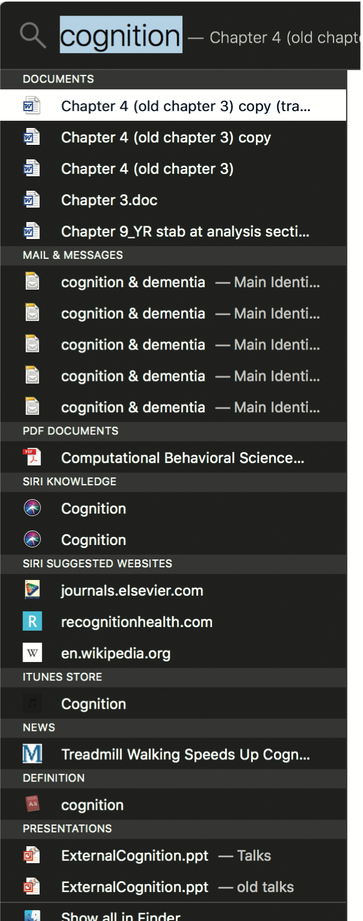
Apple’s Spotlight search tool
Notes:
34

Slide 35
Memory load
Online/mobile and phone banking now require users to provide multiple pieces of information to access their account
For instance, ZIP code, birthplace, a memorable date, first school attended
Known as multifactor authentication (MFA)
Why?
Increased security concerns
Password managers, such as LastPass, have been developed that require only one master password
Reduces stress and memory load on users
Passwords could become extinct with the widespread use of biometrics and computer vision algorithms

Slide 36
Digital Forgetting
When might you wish to forget something that is online?
When you break up with a partner
Emotionally painful to be reminded of them through shared photos, social media, and so on.
Sas and Whittaker (2013) suggest ways of harvesting and deleting digital content
For example, making photos of ex into an abstract collage
Helps with closure

Slide 37
Memory aids
SenseCam, developed by Microsoft Research Labs (now Autographer)
A wearable device that intermittently takes photos without any user intervention while worn
Digital images taken are stored and revisited using special software
Has been found to improve people’s memory, especially those suffering from dementia
Other aids include RemArc, which triggers long-term memory using old BBC materials

Slide 38
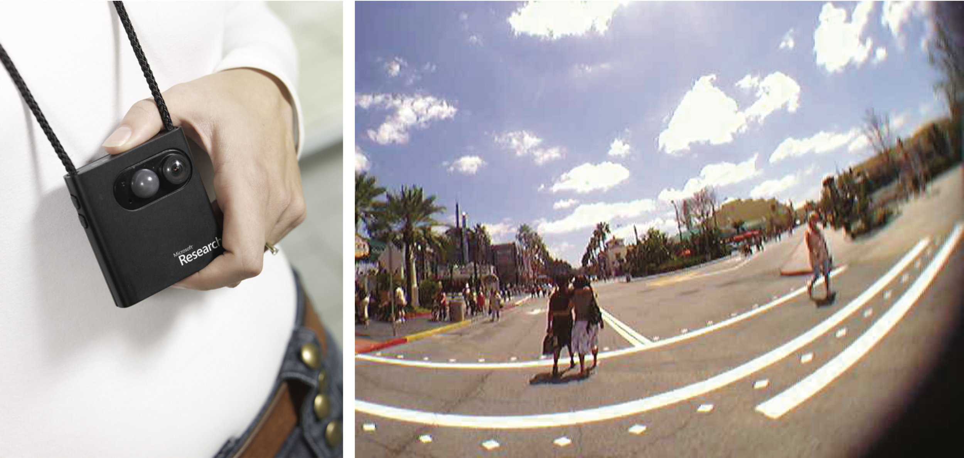
SenseCam

Slide 39
Design implications
Reduce cognitive load by avoiding long and complicated procedures for carrying out tasks
Design interfaces that promote recognition rather than recall
Provide users with various ways of labelling digital information to help them easily identify it again
For example, folders, categories, color, flagging, and time stamping
Notes:
39

Slide 40
Learning
Involves the accumulation of skills and knowledge involving memory
Two main types:
Incidental learning (for example, recognizing people’s faces, what you did today)
Intentional learning (for instance, studying for an exam, learning to cook)
Intentional learning is much harder!
Many technologies have been developed to help (for example, multimedia, animations, VR)
People find it hard to learn by following instructions in a manual
People prefer to learn by doing

Slide 41
Design implications
Design interfaces that encourage exploration
Design interfaces that constrain and guide learners
Dynamically linking concepts and representations can facilitate the learning of complex material

Slide 42
Reading, speaking, and listening
The ease with which people can read, listen, or speak differs:
Many prefer listening to reading
Reading can be quicker than speaking or listening
Listening requires less cognitive effort than reading or speaking
Dyslexics have difficulties understanding and recognizing written words

Slide 43
Applications
Voice user interfaces allow users to interact with them by asking questions
For example, Google Voice, Siri, and Alexa
Speech-output systems use artificially-generated speech
For instance, written text-to-speech systems for the visually impaired
Natural-language systems enable users to type in questions and give text-based responses
Such as, chatbots

Slide 44
Design implications
Speech-based menus and instructions should be short
Accentuate the intonation of artificially generated speech voices
They are harder to understand than human voices
Provide opportunities for making text large on a screen

Slide 45
Problem-solving, planning, reasoning, and decision-making
All these processes involve reflective cognition
For example, thinking about what to do, what the options are, and the consequences
Often involves conscious processes, discussion with others (or oneself), and the use of artifacts
Such as maps, books, pen and paper
May involve working through different scenarios and deciding which is best option
Weighing up alternatives

Slide 46
Design implications
Provide information and help pages that are easy to access for people who wish to understand more about how to carry out an activity more effectively (for example, web searching)
Use simple and memorable functions to support rapid decision-making and planning

Slide 47
Dilemma
The app mentality is making it worse for people to make their own decisions because they are becoming risk averse (Gardner and Davis, 2013)
Instead, they now rely on a multitude of apps
This makes them increasingly anxious
They are unable to make decisions by themselves
They need to resort to looking up info, getting other’s opinions on social media, and comparing notes
Do you agree?
Did it happen to you when deciding which university/school to attend?

Slide 48
Cognitive frameworks
These are used to explain and predict user behavior at the interface
Based on theories of behavior
Focus is on mental processes that take place
Also use of artifacts and representations
Most well known are:
Mental models
Gulfs of execution and evaluation
Distributed cognition
External and embodied cognition

Slide 49
Mental models
Users develop an understanding of a system through learning about and using it
Knowledge is sometimes described as a mental model:
How to use the system (what to do next)
What to do with unfamiliar systems or unexpected situations (how the system works)
People make inferences using mental models of how to carry out tasks
Notes:
49

Slide 50
More mental models
Craik (1943) described mental models as:
Internal constructions of some aspect of the external world enabling predictions to be made
Involves unconscious and conscious processes
Imagery and analogies are activated
Deep versus shallow models
For example, how to drive a car and how it works
Notes:
50

Slide 51
Everyday reasoning and mental models
You arrive home on a cold winter’s night to a cold house. How do you get the house to warm up as quickly as possible? Set the thermostat to be at its highest or to the desired temperature?
(b) You arrive home starving hungry. You look in the fridge and find all that is left is an uncooked pizza. You have an electric oven. Do you warm it up to 375 degrees first and then put it in (as specified by the instructions) or turn the oven up higher to try to warm it up quicker?
Notes:
51

Slide 52
Heating up a room or oven that is thermostat-controlled
Many people when asked (a) choose the first option
Why?
They think it will heat the room up quicker
General valve theory, where ‘more is more’ principle is generalized to different settings (for instance, gas pedal, gas cooker, tap, radio volume)
But it is a wrong mental model for thermostats based on on-off switch model
Many people when asked (b) choose the first option
Electric ovens work on the same principle as thermostats
Most of us have erroneous mental models (Kempton, 1996)
Notes:
52

Slide 53
Erroneous mental models
Lots of people hit the button for elevators and pedestrian crossings at least twice
Why? Think it will make the lights change faster or ensure that the elevator arrives!
What kinds of mental models do users have for understanding how interactive devices work?
Poor, often incomplete, easily confusable, based on inappropriate analogies and superstition (Norman, 1983)
Notes:
53

Slide 54
How can UX be designed to help people build better mental models?
Clear and easy to use instructions
Appropriate tutorials and contextual sensitive guidance
Provide online videos and chatbot windows when needing help
Transparency: to make interfaces intuitive to use
Affordances of what actions an interface allows
For example, swiping, clicking, or selecting

Slide 55
Gulfs of execution and evaluation
The ‘gulfs’ explicate the gaps that exist between the user and the interface
The gulf of execution
The distance from the user to the physical system
The gulf of evaluation
The distance from the physical system to the user
Bridging the gulfs can reduce cognitive effort required to perform tasks
Can reveal whether interface increases or decreases cognitive load and whether it is obvious what to do next (Norman, 1986; Hutchins et al, 1986)
Notes:
55

Slide 56
Bridging the gulfs

Slide 57
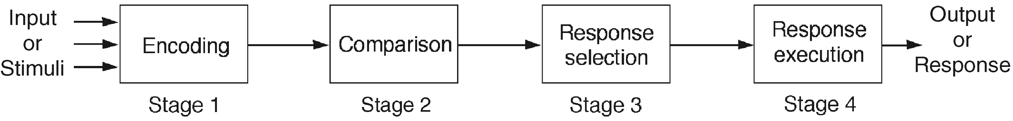
Information processing
Conceptualizes human performance in metaphorical terms of information processing stages
Notes:
57
A number of comparisons have been made, including conceptualizing the mind as a reservoir, a telephone network, and a digital computer. One prevalent metaphor from cognitive psychology is the idea that the mind is an information processor. Information is thought to enter and exit the mind through a series of ordered processing stages. Within these stages, various processes are assumed to act upon mental representations. Processes include comparing and matching. Mental representations are assumed to comprise images, mental models, rules, and other forms of knowledge.

Slide 58
Limitations
Based on modeling mental activities that happen exclusively inside the head
Do not adequately account for how people interact with computers and other devices in real world

Slide 59
Distributed cognition
Concerned with the nature of cognitive phenomena across individuals, artifacts, and internal and external representations (Hutchins, 1995)
Describes these in terms of propagation across representational state
Information is transformed through different media (computers, displays, paper, heads)
Notes:
59

Slide 60
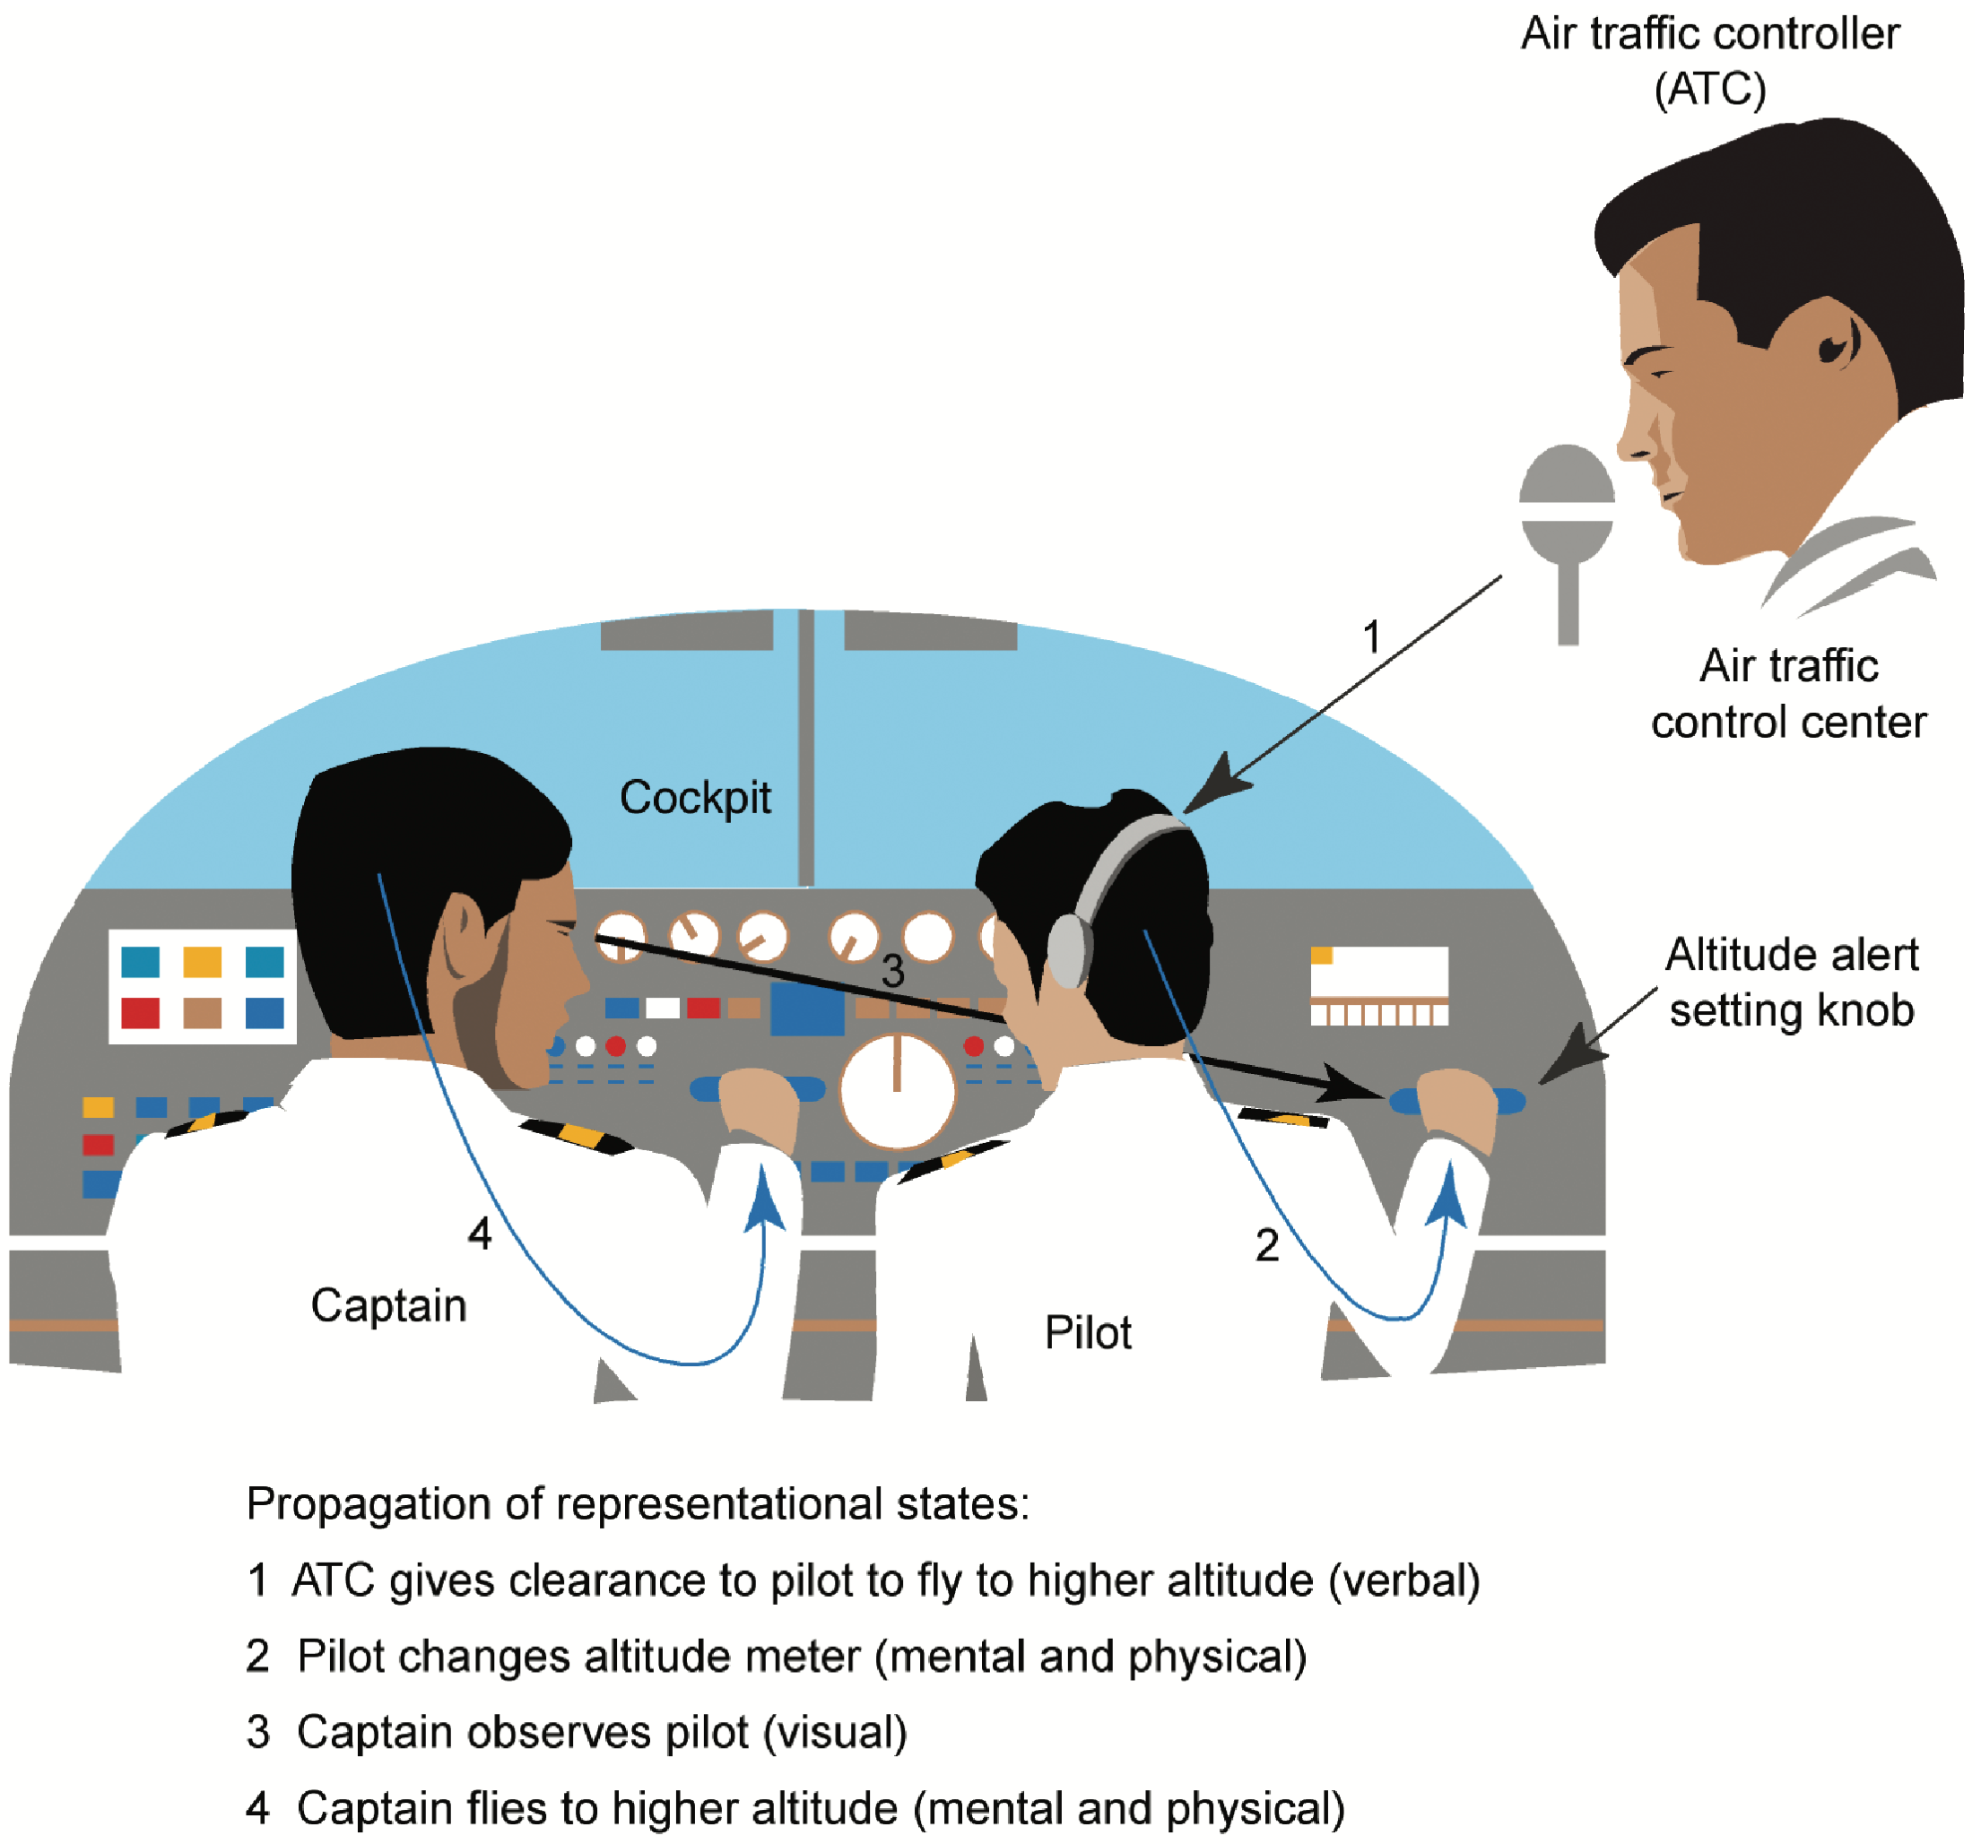
A cognitive system for ATC

Slide 61
What’s involved
The distributed problem-solving that takes place
The role of verbal and non-verbal behavior
The various coordinating mechanisms that are used (for example, rules and procedures)
The communication that takes place as the collaborative activity progresses
How knowledge is shared and accessed
Notes:
61

Slide 62
External cognition
Concerned with explaining how we interact with external representations (such as maps, notes, and diagrams)
What are the cognitive benefits and what processes involved
How they extend cognition
What technologies can we develop to help people carry out complex tasks (for example, learning, problem solving, and decision-making)?
Notes:
62

Slide 63
Externalizing to reduce memory load
Examples include the use of diaries, reminders, calendars, notes, shopping lists, to-do lists
Written to remind us of what to do
Post-its, piles, marked emails are used to:
Where placed indicates priority of what to do
External representations:
Remind us that we need to do something (for example, to buy something for mother’s day)
Remind us of what to do (for instance, buy a card)
Remind us when to do something (for example, send a card by a certain date)
Notes:
63

Slide 64
Computational offloading
When a tool is used in conjunction with an external representation to carry out a computation (for instance, pen and paper)
Try doing the two sums below (a) in your head, (b) on a piece of paper, and (c) with a calculator.
234 ×456 = ??
CCXXXIIII×CCCCXXXXXVI = ???
Which is easiest and why? Both are identical sums
Notes:
64

Slide 65
Annotation and cognitive tracing
Annotation involves modifying existing representations through making marks
For example, crossing off, ticking, and underlining
Cognitive tracing involves externally manipulating items into different orders or structures
For instance, playing Scrabble or cards
Notes:
65

Slide 66
Design implication
Provide external representations at the interface that can reduce memory load and facilitate computational offloading
For example, information visualizations have been designed to allow people to make sense and rapid decisions about masses of data
Notes:
66

Slide 67
Embodied Interaction
The practical engagement with the social and physical environment (Dourish, 2001)
Creating, manipulating and making meaning through our interaction with things
How our bodies and active experiences shape how we perceive, feel, and think (Hornecker et al., 2017)
They enable us to develop a sense of the world at both a concrete and abstract level
Can provide new ideas about interaction and better design principles
For example, we think with our bodies not through them (Kirsh, 2013)

Slide 68
Summary
Cognition involves many processes including attention, memory, perception, and learning
The way an interface is designed can greatly affect how well users can perceive, attend, learn, and remember how to do their tasks
Theoretical frameworks, such as mental models and external cognition, provide ways of understanding how and why people interact with products
This can lead to thinking about how to design better products
Notes:
68

Slide 69
In-depth activity
Write down how you think a contactless card or smartphone app like Apple Pay works
What information is sent between the card/smartphone and the card reader when it is placed in front of it?
What is the maximum amount you can pay for something using a contactless card, Apple Pay or Google Pay?
Why is there an upper limit?
How many times can you use a contactless card or Apple/Google Pay in a day?
What happens if you have two contactless cards in the same wallet/purse?
What happens when your contactless card is stolen and you report it to the bank? What does the bank do?
Notes:
69

